Slide 1
Digital Earth GEOG-104 Week 2: Map Projections
Yi Qiang

Slide 2
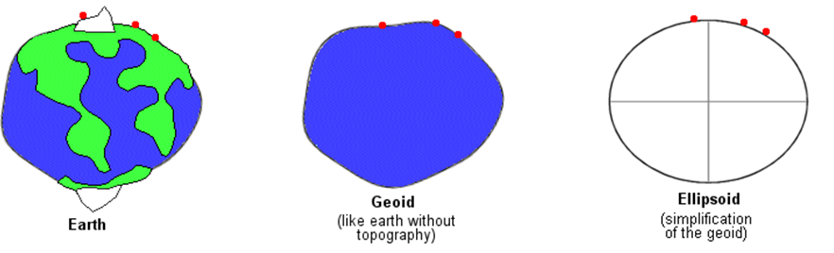
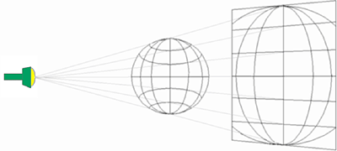
Coordinate systems
Geographic coordinate systems – transform locations on a irregular shape of the earth to Lag/Long coordinates in an spheroid/ellipsoid
Projected coordinate systems (map projection) – transform locations on the earth’s spherical/ellipsoidal surface onto a flat map surface

Slide 3
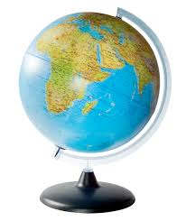
Globes Versus Flat Maps
Using a geographic coordinate system, we can transform locations on the earth surface to a spheroid/ellipsoid.
Then, we can create a model (i.e. a globe) to represent the spheroid/ellipsoid.
Why we want to project things onto a map?

Slide 4
Globes Versus Flat Maps
Globes
Pros:
A more realistic model of the earth
Basic geometric properties (e.g. distance, direction, shape, and area)
Cons:
Can’t view all parts of the earth’s surface simultaneously.
Bulky, not easy to carry and store.
Distance, direction and areas are difficult to measure.
Costly to produce

Slide 5
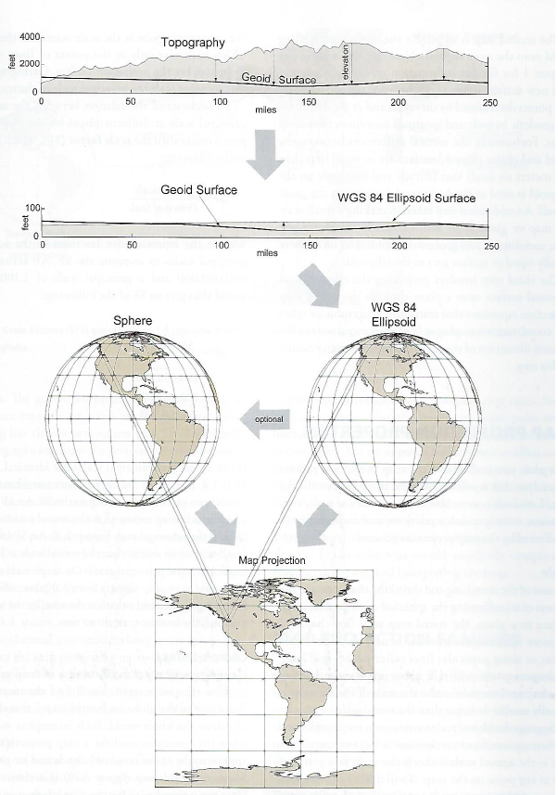
Project locations onto maps
Remove topography from the earth surface -> geoid (mean sea level rise)
Transform the geoid into a spheroid or ellipsoid using a datum
Project the spheroid/ellipsoid onto a planar map

Slide 6
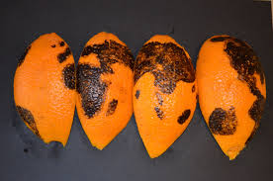
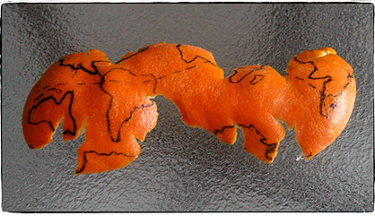
Spheroid to map
The spheroid surface cannot be transformed to a contiguous flat map.
The curvature of the spheroid surface cannot completely flattened.
Imagine you have a fresh navel orange. This is your imaginary Earth. When you look at it any direction, you won’t be able to see all sides of it. But when you peel the orange, flatten and stretch it out, you can begin to see everything.

Slide 7
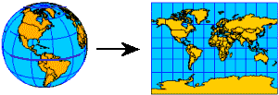
Map projection
A map projection uses mathematical formulas to convert geographic coordinates on the spherical globe to planar coordinates on a flat map.
A projected coordinate system is a reference system for identifying locations and measuring features on a flat (map) surface.

Slide 8
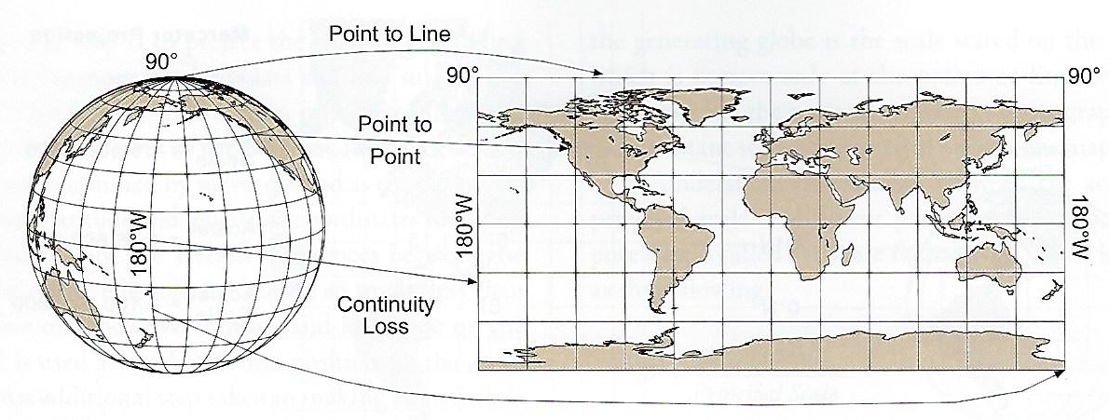
Map projection
There are geometric transformations to flatten the spheroid surface.
An example of map projection
What are distorted in the planar map?
1. Are meridians converge?
2. Do meridians and parallels intersect at a right angle?
3. Do parallels shorten with increasing latitude?
4. Are the areas of quadrilaterals on the projection the same as on the globe?

Slide 9
Distortions
In a map projection, only some of the properties (shape, area, distance, and direction) can be preserved, and other properties are distorted.
Map projections can also be grouped into families according properties being preserved.
Equidistance projection (partially preserving distance)
Conformal projection (preserving angle, i.e. shape)
True direction projection or azimuthal projection (preserving direction)
Equivalence projection (preserving area)

Slide 10
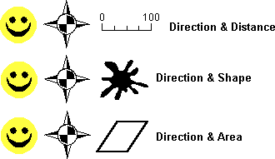
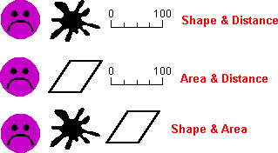
Preserving properties
If two properties are to be preserved then one is always direction
These properties are incompatible

Slide 11
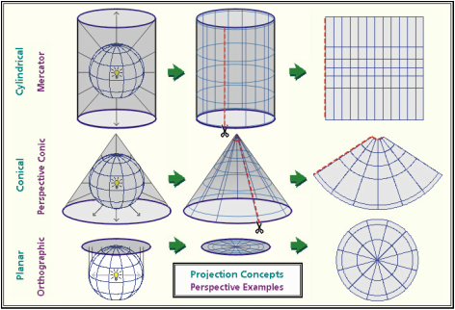
Type of Map Projections
Map projections can be grouped into families according to projection surface.

Slide 12
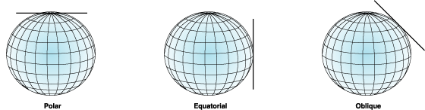
Planar Projection (azimuthal projection)
Projecting the globe surface onto a flat plane that touches the globe at a point or slice through the globe.

Slide 13
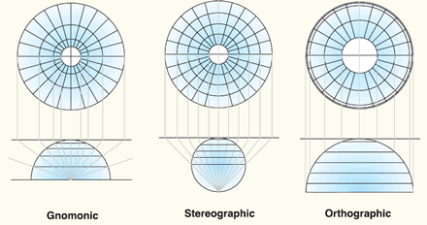
Planar Projection
Three common types of true perspective planar projections:
Note the different patterns of parallels and meridians.

Slide 14
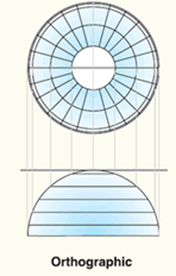
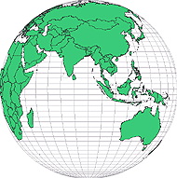
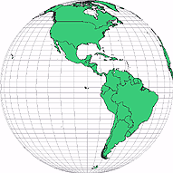
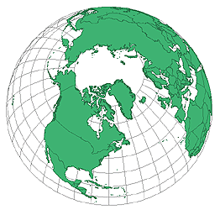
Planar projection
Orthographic projection – how the world would appear if viewed from a distant planet.
All properties (distance, shape, direction, are area) are distorted.
The closer to the ‘touching point’, the less distorted.
Only one hemisphere can be viewed at one time.
Orthographic projection centered at different locations

Slide 15
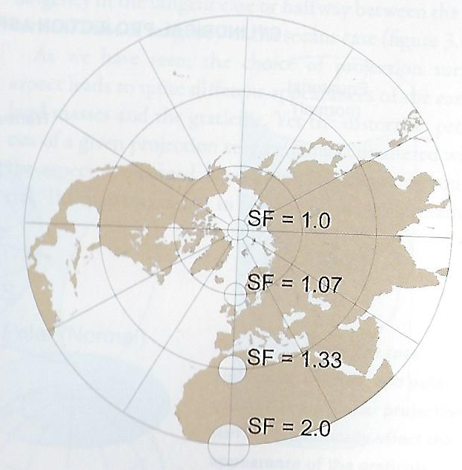
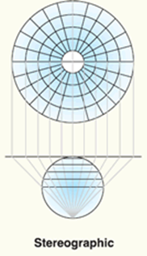
Planar projection
Stereographic projection – projecting a light source from the antipodal point on the globe to a tangent plane.
Conformal projection (shape is preserved)
Commonly used for polar area projection
Generally limited to one hemisphere.
A north pole map in stereographic projection

Slide 16
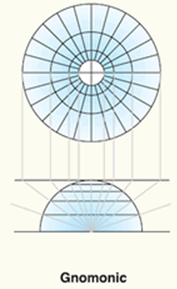
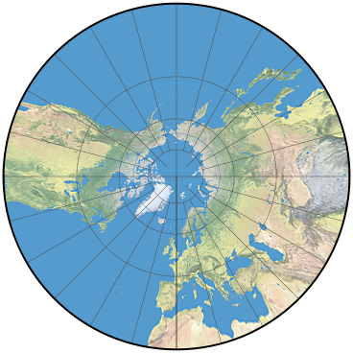
Planar projection
Gnomonic projection – projecting a light source from the center of the globe to a tangent plane.
Originally used to map constellations in star charts
All properties are distorted
The shortest path on the globes are straight lines – for navigations
Significant distortion near the edge
A north pole map in gnomonic projection

Slide 17
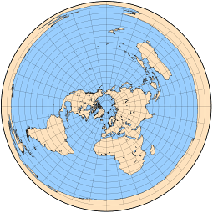
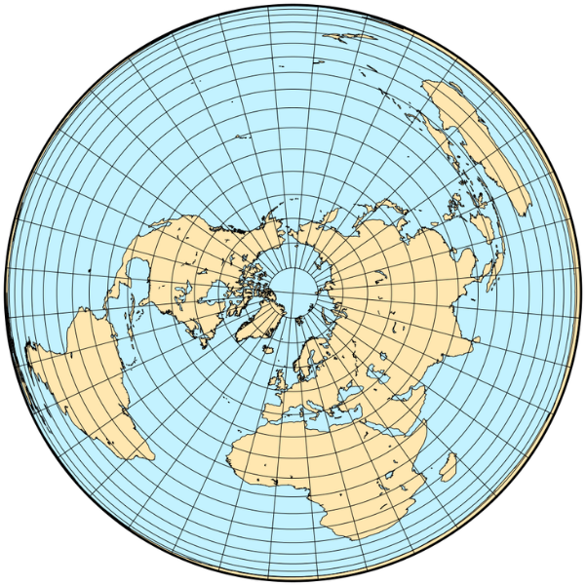
Other planar projection
Azimuthal equidistant projection
Lambert azimuthal equal area
Distances from the tangency point (the pole) to other places are the same as on the globe.
Used for navigation or radar maps.
Distort the shape near the edge to preserve distance (Australia and South America in the above map)
More used for countries or continents with a circular boundary

Slide 18
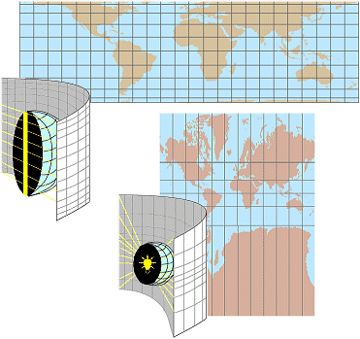
Cylindrical Projection
Projecting the globe onto a cylinder that touches or slice through the globe.
Cylindrical equal area projection
Central cylindrical projection

Slide 19
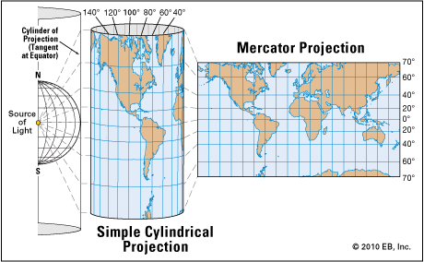
Cylindrical Projection
Mercator projection – a variant of central cylindrical projection
Conformal projection (shape and direction are preserved)
Cut off at 80°N and S (great distortion near poles)

Slide 20
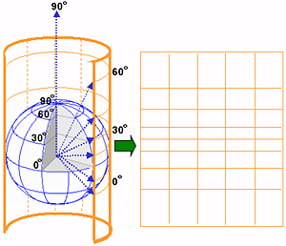
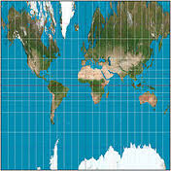
Cylindrical Projection
Cylindrical projection cannot project the poles onto the projection surface.
Additional transformation or a special projection is needed for the polar areas.

Slide 21
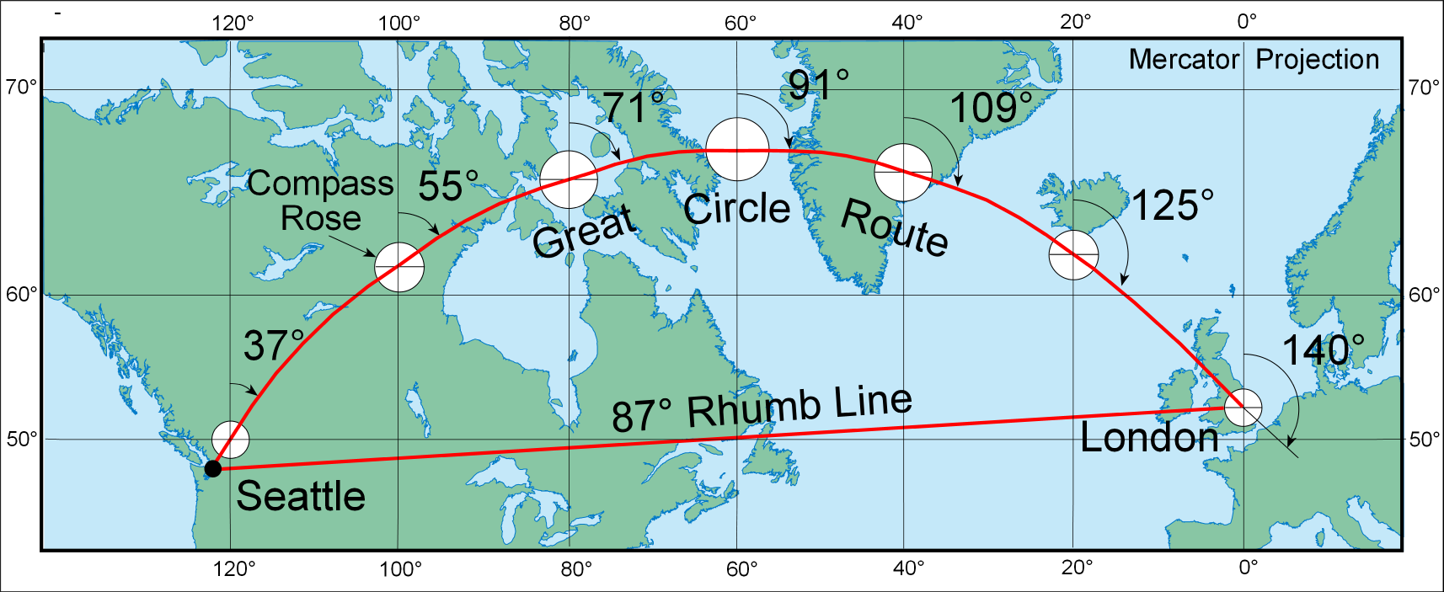
Cylindrical Projection
Mercator projection – the rhumb line is not the shortest path

Slide 22
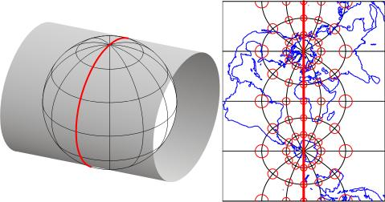
Cylindrical Projection
Traverse Mercator projection – rotate the cylindrical surface by 90° so that the tangent line becomes a pair of meridian lines.
Traverse Mercator projection

Slide 23
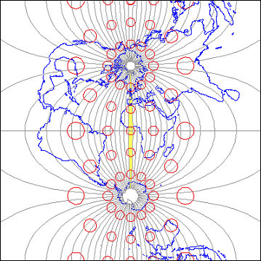
Cylindrical Projection
Traverse Mercator projection
Conformal projection (shape is preserved)
Area is preserved along the tangent line
Traverse Mercator projection

Slide 24
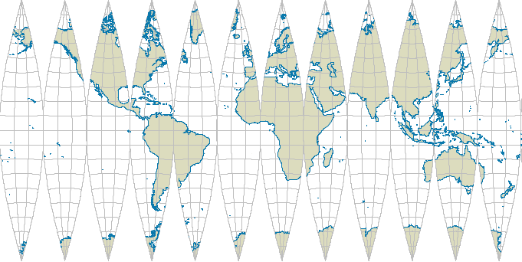
Cylindrical Projection
Gores of the globe on transverse Mercator projection with 30° width - Traverse projection along equal-interval meridians
Drawback: non-contiguous

Slide 25
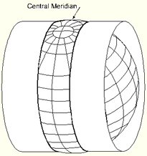
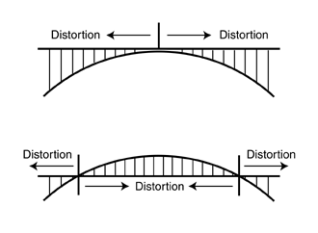
Cylindrical Projection
Universal Traverse Mercator (UTM) projection
Use a cylinder to peel the globe surface into strips (divides the Earth's surface into 60 zones, each spanning 6° of longitude)
Property distortions are minimized within each strip (not completely preserved)
Polar areas (above 84° North and 80° South) are excluded.
More used for projection of small areas

Slide 26
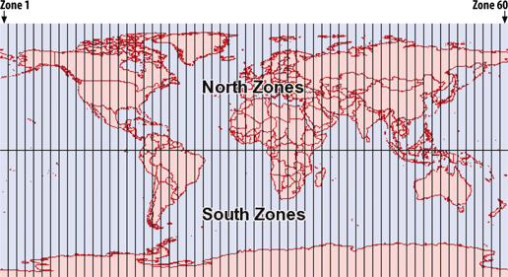
Cylindrical Projection
Universal Traverse Mercator (UTM) projection
UTM zones

Slide 27
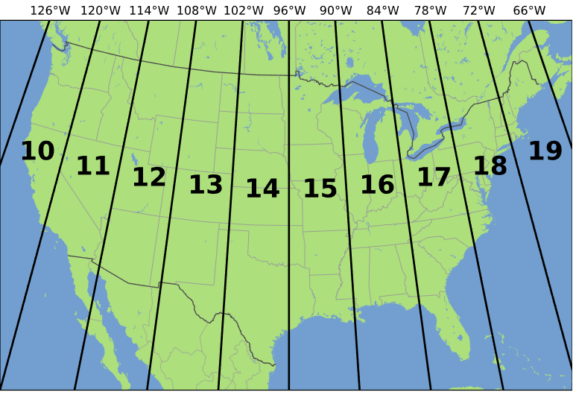
Cylindrical Projection
Universal Traverse Mercator (UTM) projection
UTM zones in the contiguous US

Slide 28
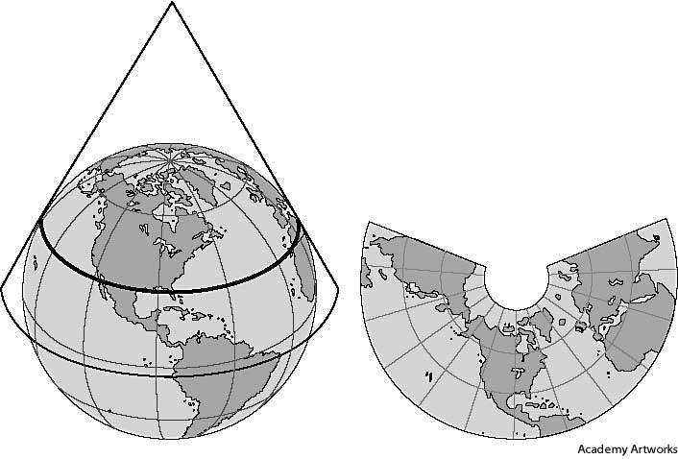
Conic Projection

Slide 29
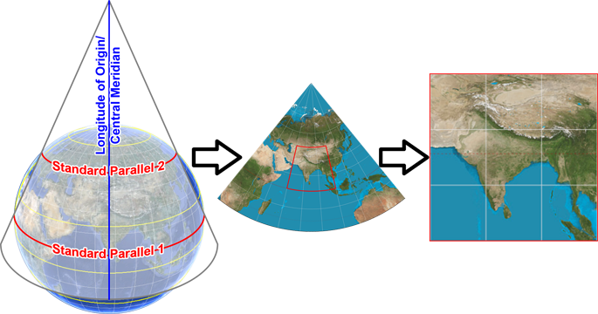
Conic Projection
Lambert conformal conic - A conic projection in which the conic projection surface slices through the globe at 33°N and 45°N to keep the scale distortion minimum at the edge.
Conformal projection (shape and direction are preserved locally)
The straight line between two points is almost the same as the shortest path (great circle) on the globe.
Lambert conformal conic

Slide 30
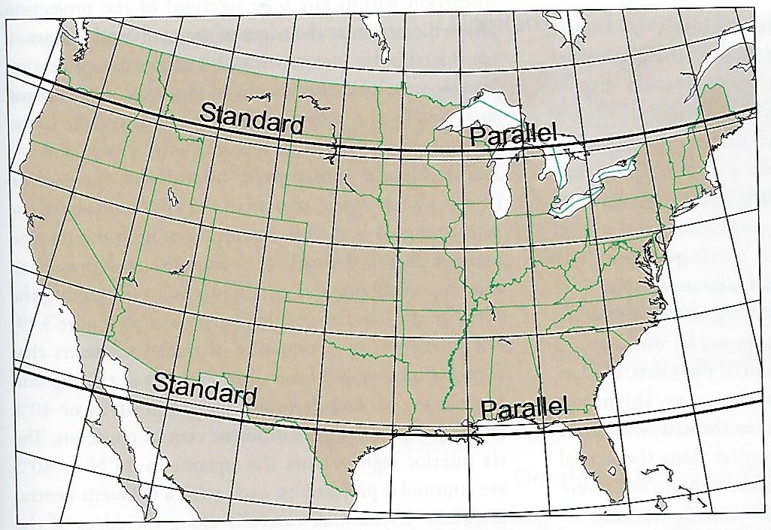
Conic Projection
Albers equal area conic - the conic projection surface slices through the globe at 29.5°N and 45.5°N to keep the scale distortion minimum at the edge.
Area is accurately preserved
Less than 1% distance distortion in the middle (37°N) of the map, 1.25% distortion at the south and north edge
Most used projection for statistical maps of the U.S. (e.g. maps from the U.S. Census Bureau)
Albers equal area conic projection of the United States

Slide 31
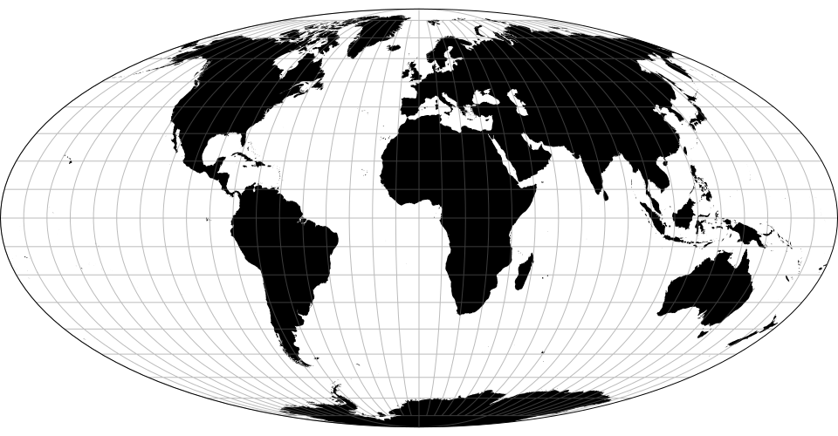
Other projections
The abovementioned projections are only a small portion of the vast array of projections. Some projections use more complex mathematical/geometrical transformation that cannot be intuitively classified into the above families.
Mollweide projection
A pseudocylindrical projection that use equator as the standard parallels and the prime meridian as the central meridian
An equal area projection
Intuitive “earth-like”
Shape distortion is less than other equal area world projections
Mollweide projection

Slide 32
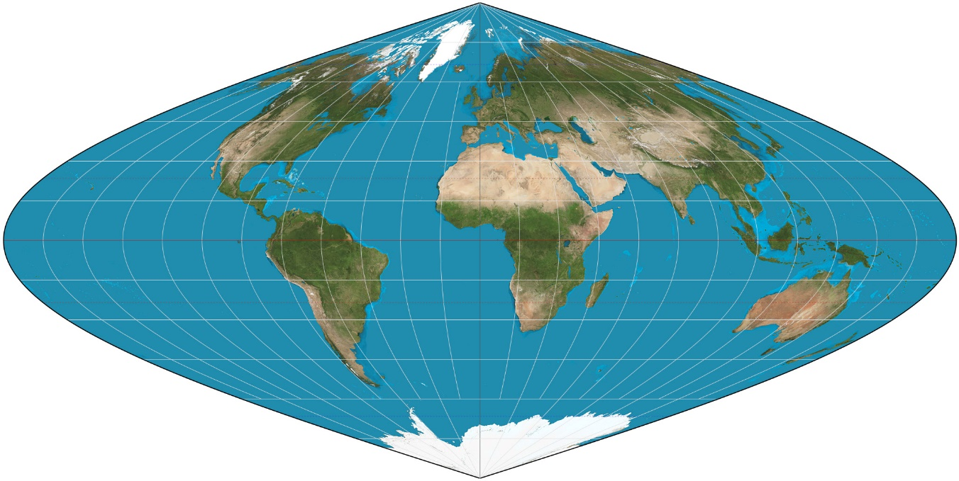
Other projections
Sinusoidal projection
An equal area projection
Equidistant in the east-west or north-south direction
Severe shape distortion at edges
Sinusoidal projection

Slide 33
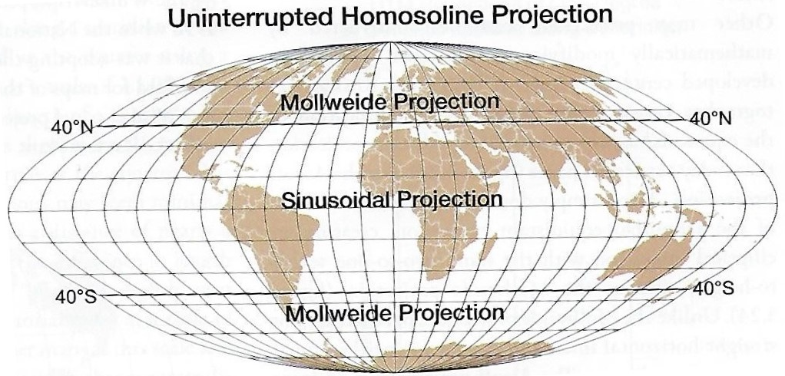
Other projections
A composite of two projections
Sinusoidal projection is used between 40°N and 40°S, while Mollweid projection is used for the rest areas (near pole areas)
Shape is less distorted than sinusoidal projection
Uninterrupted Homolosine projection

